Slide 1
BITS Pilani presentation
Amit Dua
Department of Computer Science and Information Systems

Slide 2
CS F212
Database Systems
Lecture No. 1

Slide 3
Lecture outline
Database definitions
Characteristics of database approach
Data Models
Architecture
Entity relationship model basics

Slide 4
About me
Instructor-in-Charge: Dr. Amit Dua
Office: 6120-K
Email: amit.dua@pilani.bits-pilani.ac.in
Chamber Consultation hours: Monday 5-6 Pm

Slide 5
Database Definition
Database: collection of related data
Data: recorded facts with meaning
Represents real-world (mini world)
Well planned, clear, and some meaning
For a purpose
Any size and complexity

Slide 6
DBMS
DBMS: software that facilitates
  Defining
  Constructing
  Manipulating
  Sharing of database
Application programs requests DBMS for data
  Query
  Transaction
Database + DBMS software = Database systems

Slide 7
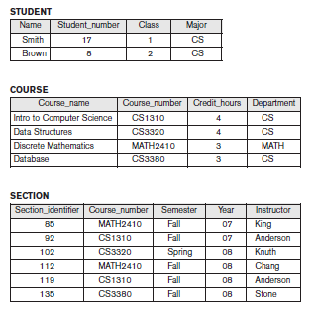
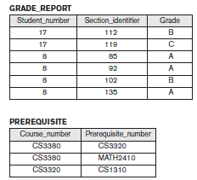
University Database
Courtesy: T1, Elmasri & Navathe

Slide 8
Design an Application
Requirement specification and analysis
  Conceptual design
Logical design
  Relational DBMS
Physical design

Slide 9
Ques
We can use C++/Java to write a data, read and update the data. Why need a new software and a fresh approach?

Slide 10
Characteristics of Database approach
Self describing data
Abstraction
  Program-data independence (Separation of programs and data)
  Data model helps in representing what is required
  Abstracts implementation details
Multiple views
Sharing and Multiuser transactions

Slide 11
Discussion
What can be queries and update operations?

Slide 12
Discussion
What can be storage structure and search techniques?

Slide 13
Discussion
What are the relationships among records?

Slide 14
Integrity constraints
Restrictions/constraints that must hold for data
E.g. data type, Not Null,
Referential Integrity:
Section must be related to a course record
Key/Uniqueness:
Course_number must have a unique for all values of course record

Slide 15
Discussion
What are the integrity constraints?

Slide 16
Data Models
Concepts that helps to describe data types, relationships, and constraints.
High level/conceptual:
  Very close to user
  Entity
  Attribute
  Relationship
  e.g. Entity Relationship model
Low level / physical data model
  How data is stored and organized in storage media
  Access path
  Index

Slide 17
Data Models
Representational/ Implementation
  Easily understood by end user
  Not far from data organization and storage
  Relational data model (network, hierarchical data models)
Object data model
  Higher level implementation model closer to conceptual data model
Self-describing data models
  Schema of data and data combined

Slide 18
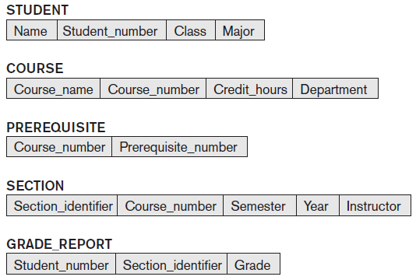
Schema
Description of data: Names of records, data types, constraints

Slide 19
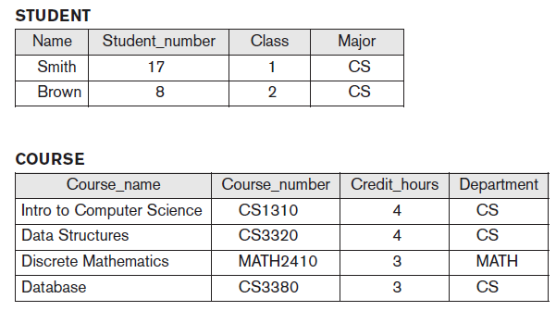
Instance
State satisfying structure and constraints of schema is valid state

Slide 20
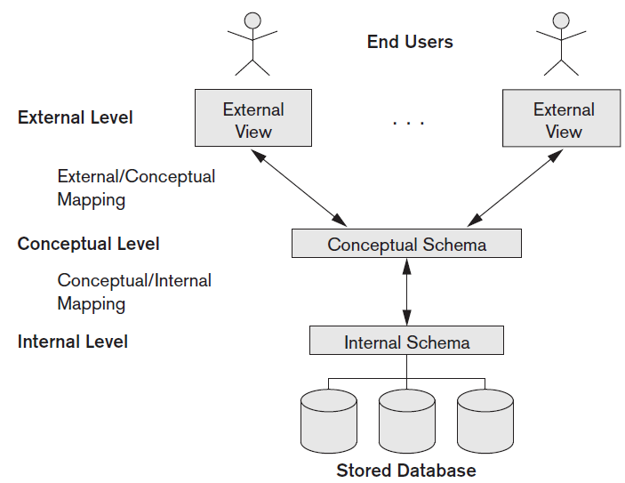
Three-schema architecture

Slide 21
Discussion
What is difference between database schema and database state?

Slide 22
Discussion
What is the need for mapping among schema levels?

Slide 23
Evaluation components

Slide 24
Text Book
TB:
Abraham Silberschatz, Henry F Korth and S Sudarshan, Database System Concepts, McGraw Hill, 6th Ed., 2013
R1: Ramez Elmasri & Shamkant B. Navathe, Database Systems; Models, Languages, Design and Application Programming, Pearson Education, 7th Edition, 2017.
Database Design and Applications (CSI ZG518/ SSZG518)

Slide 25
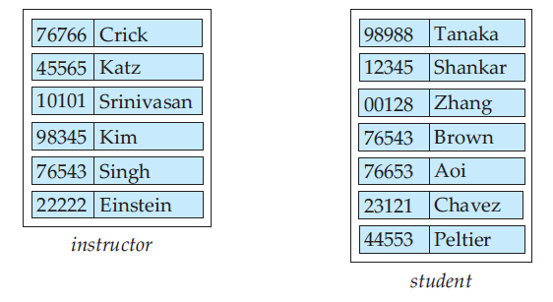
Entities
Entity: any thing or an object. E.g. Amit
Attribute: property that describes entity
  Name and Id number
Entity set: e.g. instructor, student

Slide 26
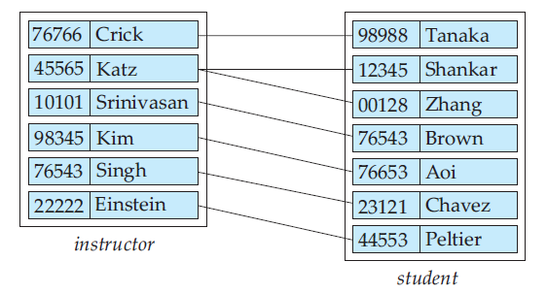
Relationship
Association among several entities.
  Advisor relationship between crick and tanaka
Set of relationships of same type
  E.g. advisor relationship set (set of all different relationships as advisior)

Slide 27
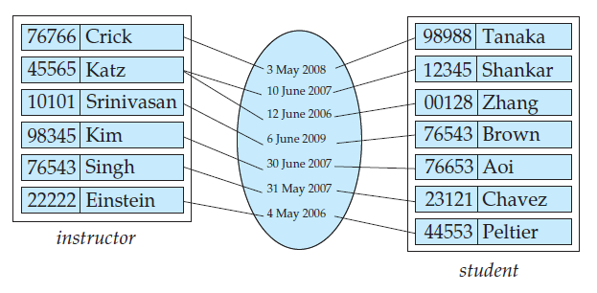
Relationship sets
date as attribute of the advisor relationship set

Slide 28
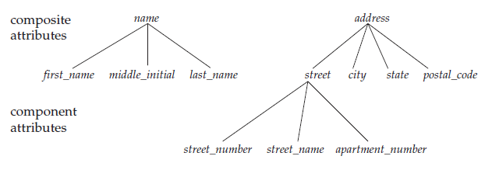
Attributes
Based on subdivision
Simple: No subdivision
  E.g. salary
Composite: With subdivision
  Name (F Name, M Name, L Name)
  Address

Slide 29
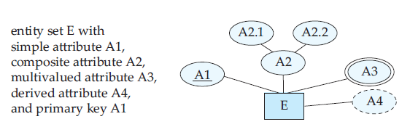
Attributes contd..
Number of values
Single valued
  Date of birth
Multivalued
  Phone number
Stored:
  Date of birth
Derived
  Age

Slide 30
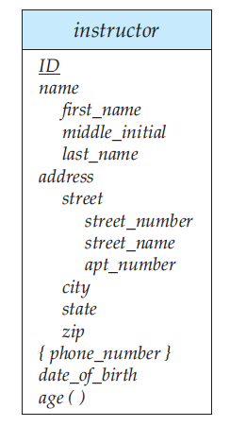
Complex attributes
Complex: multivalued and composite
  More than one address with
  each address having more than one phone

Slide 31
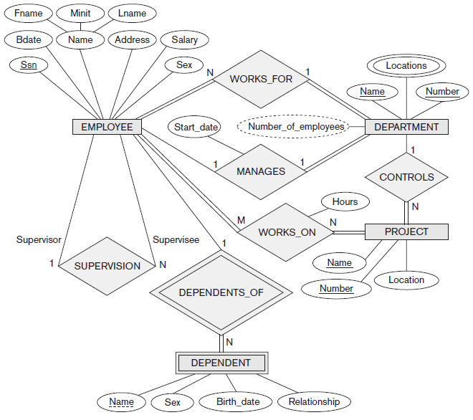

Slide 32
Course Outline
Overview of Database Systems
Foundations
  Data Models: ER, Relational Models
  Query languages : RA, SQL
Design & Development
  Normalization, Application Development
Efficiency & Scalability
  Storage & Indexing
  Query evaluation & optimization
Concurrency & Robustness
  Transaction Management – concurrency, recovery
Database Design and Applications (CSI ZG518/ SSZG518)

Slide 33
Discussion
What is the type of following attributes for person entity type
Name
Age
Phone number
Address
Date of birth

Slide 34
Discussion
What is the type of following attributes for person entity type
Name: composite, single valued, stored
Age : simple, single valued, derived
Phone number: simple, multi-valued, stored
Address: composite, single valued, stored
Date of birth: simple, single valued, stored

Slide 35
Why Study Databases??
Simply fascinating
  Commercially very relevant !!
DBMS encompasses most of CS
  OS, languages, theory, AI, multimedia, logic
Significance of Databases with Internet
Datasets increasing in diversity and volume.
  Numeric and Textual Databases
  Multimedia Databases
  Geographic Information Systems (GIS)
  Data warehousing, Data mining, Business Intelligence
  Digital libraries, interactive video.
  ... need for DBMS exploding
Database Design and Applications (CSI ZG518/ SSZG518)

Slide 36
Tsunami of Data
Telecom data (≈ 4.6 bn mobile subscribers)
There are 3 Billion Telephone Calls in US each day,
30 Billion emails daily, 1 Billion SMS, IMs.
IP Network Traffic: up to 1 Billion packets per hour per router. Each ISP has many (hundreds) routers!
WWW
Weblog data (160 mn websites)
Email data
Satellite imaging data
Social networking sites data
No. of pics on Facebook
  15 bn unique photos
  60 bn photos stored (4 sizes)
Database Design and Applications (CSI ZG518/ SSZG518)

Slide 37
Big Names in Database Systems
Company Product
Oracle Oracle 8i, 9i, 10g,11g, 12c, 18c
IBM DB2, Universal Server
Microsoft Access, SQL Server-2008
Sybase Adaptive Server
Informix Dynamic Server
Database Design and Applications (CSI ZG518/ SSZG518)

